Slide 1
Continuous Delivery
Build and Deploy Automation
v1.0.1 - 20201001

Slide 2
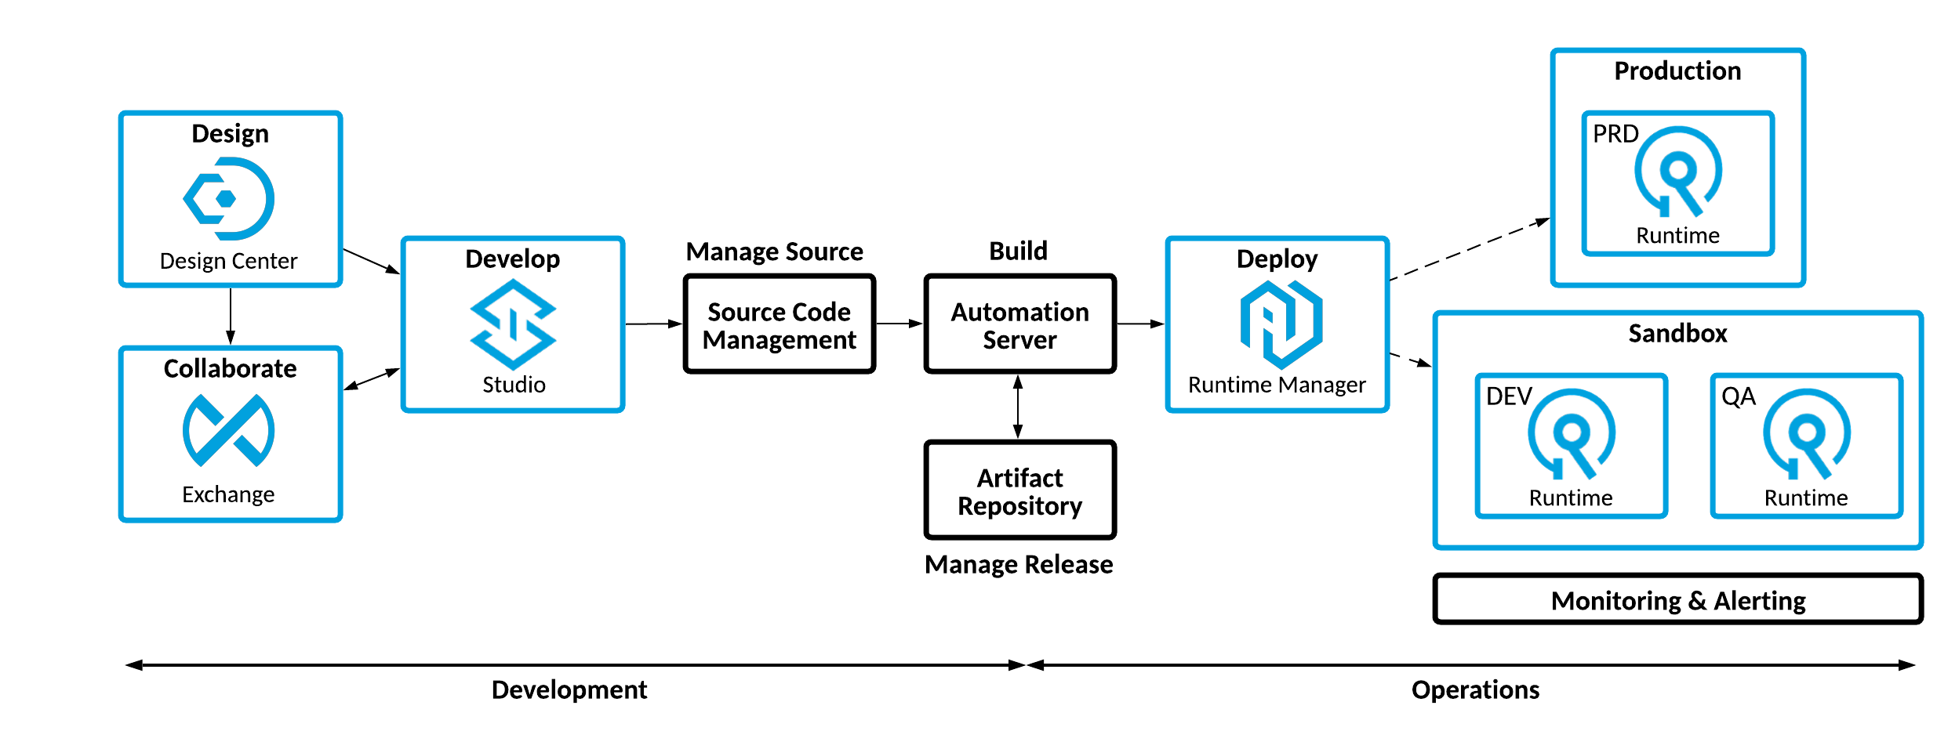
Build & Deploy Automation
Build
Deploy

Slide 3
Continuous Delivery
Continuous Delivery incorporates a variety of software deployment best practices that streamline the process of deploying applications into target environments. These best practices include:
Automation - A single command should have the capability of deploying the application.
Deployments are Always Current - Making builds readily available to stakeholders and testers can reduce the amount of rework necessary when a new feature has been introduced.
Deployment Transparency - Quickly identify deployment failures and the associated code changes that caused them.

Slide 4
Continuous Delivery
using an Artifact Repository

Slide 5
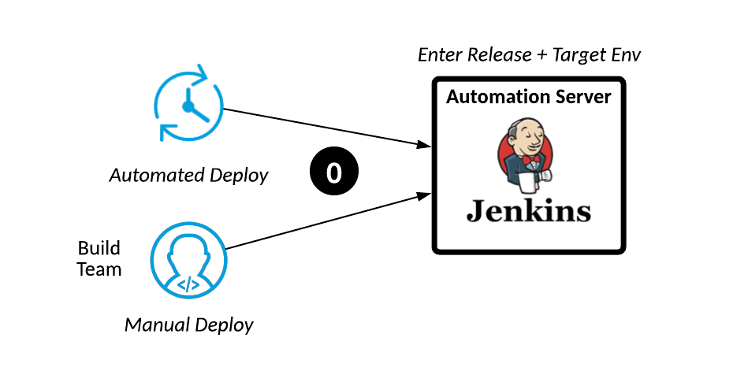
Step 0: Trigger a Deploy

Slide 6
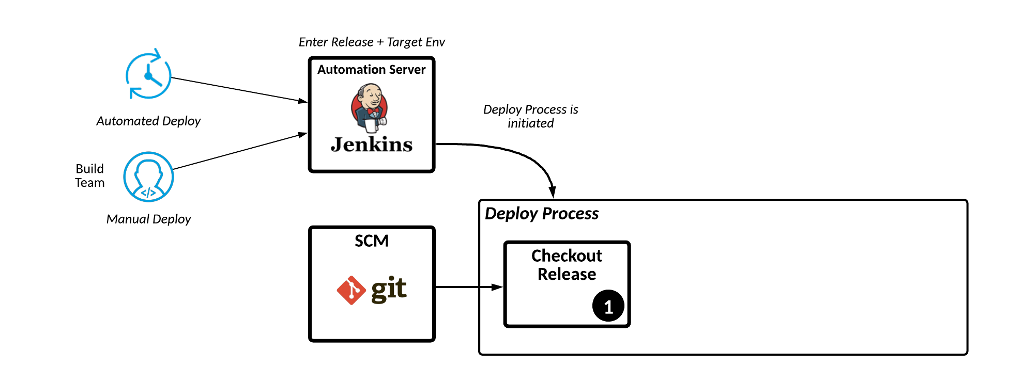
Step 1: Checkout the Release Branch

Slide 7
Step 1: Jenkins Pipeline
stage('Checkout Release Branch') { steps { script { echo "Checking out version ${params.VERSION}..." checkout([$class: 'GitSCM', branches: [[name: "${params.VERSION}"]], doGenerateSubmoduleConfigurations: false, extensions: [], submoduleCfg: [], userRemoteConfigs: [[credentialsId: 'jenkins-user-token', url: 'https://github.com/kh/edge-system-api']]])
}
} post { success { echo "...Branch ${params.VERSION} Checkout Succeeded for ${params.VERSION}: ${currentBuild.currentResult}" } unsuccessful { echo "...Branch ${params.VERSION} Checkout Failed for ${params.VERSION}: ${currentBuild.currentResult}" } } }
1

Slide 8
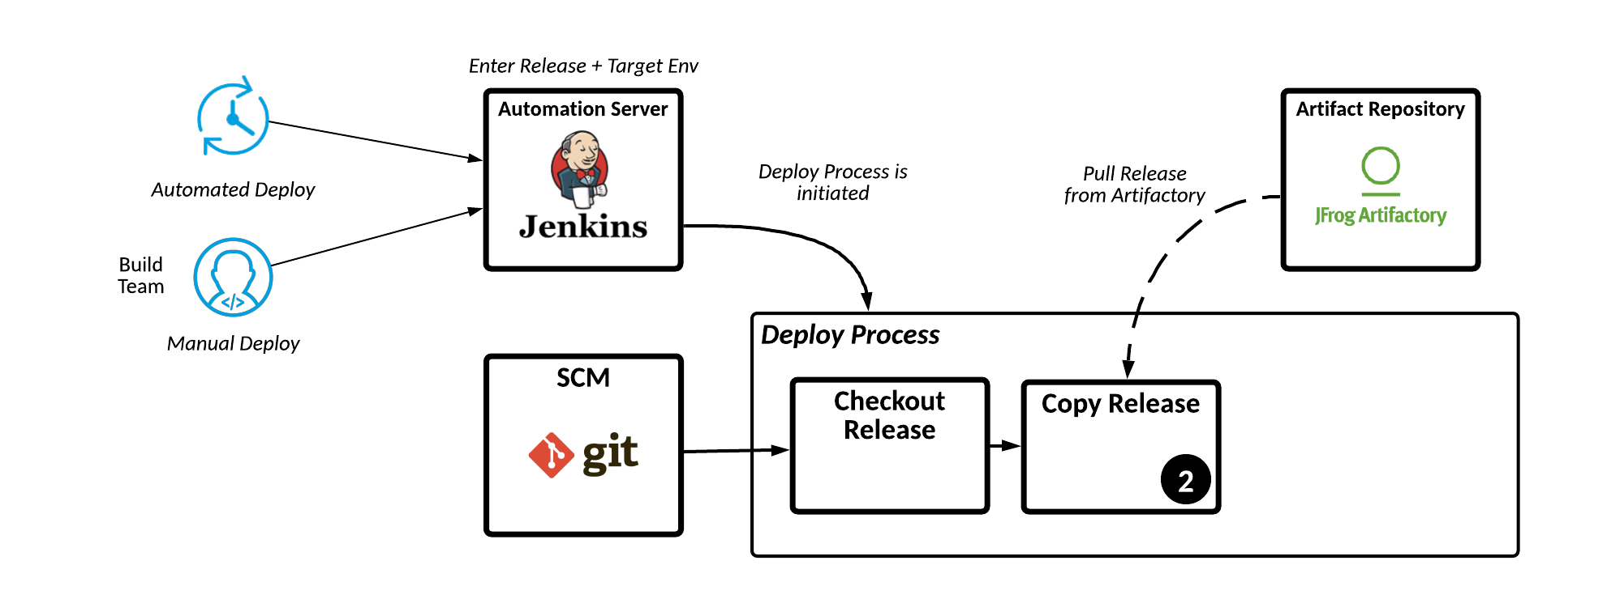
Step 2: Copy the Release

Slide 9
Step 2: Jenkins Pipeline
stage('Copy Release from Artifact Management Repository') { steps { script { echo "Copying the ${params.VERSION} artifact from the artifact repository..." pom = readMavenPom() echo "POM groupId: ${pom.groupId}" echo "POM artifactId: ${pom.artifactId}" echo "Release: ${params.VERSION}"
echo "Packaging: ${params.packaging}" echo "Current Build Number: ${currentBuild.number}" configFileProvider([configFile(fileId: '107138b1-fdbe-45c5-8eb3-64a520257c07', targetLocation: 'settings.xml', variable: 'MAVEN_SETTINGS_XML')]) { sh """mvn -s $MAVEN_SETTINGS_XML org.apache.maven.plugins:maven-dependency-plugin:3.1.1:copy -Dartifact=${pom.groupId}:${pom.artifactId}:${params.VERSION}:${params.packaging} -DoutputDirectory=/tmp/apps""" } } } post { success { echo "...Artifact Version ${params.VERSION} Checkout Succeeded: ${currentBuild.currentResult}" } unsuccessful { echo "...Artifact Version ${params.VERSION} Checkout Failed: ${currentBuild.currentResult}" } } }
1

Slide 10
Step 2: Jenkins Pipeline
stage('Copy Release from Artifact Management Repository') { steps { script { echo "Copying the ${params.VERSION} artifact from the artifact repository..." pom = readMavenPom() echo "POM groupId: ${pom.groupId}" echo "POM artifactId: ${pom.artifactId}" echo "Release: ${params.VERSION}"
echo "Packaging: ${params.packaging}" echo "Current Build Number: ${currentBuild.number}" configFileProvider([configFile(fileId: '107138b1-fdbe-45c5-8eb3-64a520257c07', targetLocation: 'settings.xml', variable: 'MAVEN_SETTINGS_XML')]) { sh """mvn -s $MAVEN_SETTINGS_XML org.apache.maven.plugins:maven-dependency-plugin:3.1.1:copy -Dartifact=${pom.groupId}:${pom.artifactId}:${params.VERSION}:${params.packaging} -DoutputDirectory=/tmp/apps""" } } } post { success { echo "...Artifact Version ${params.VERSION} Checkout Succeeded: ${currentBuild.currentResult}" } unsuccessful { echo "...Artifact Version ${params.VERSION} Checkout Failed: ${currentBuild.currentResult}" } } }
2

Slide 11
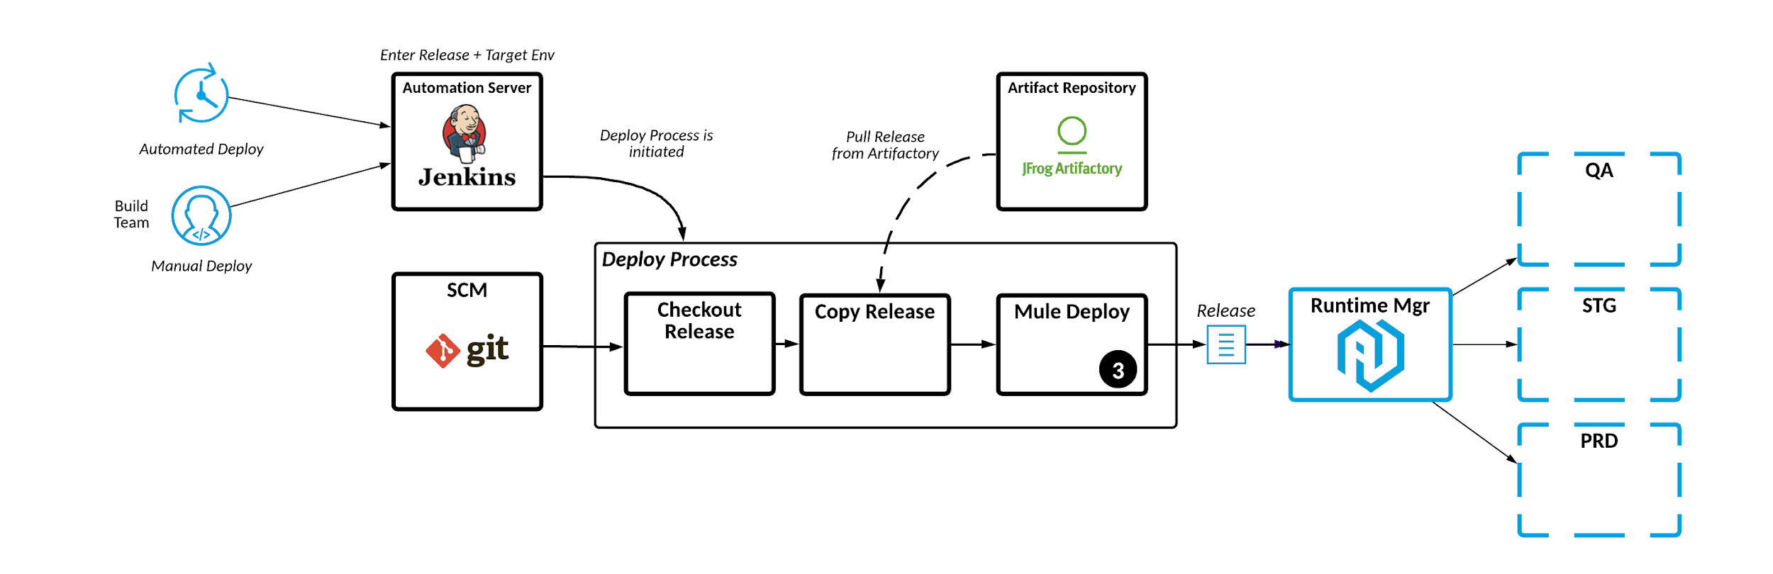
Step 3: Deploy the Release to Runtime Manager

Slide 12
Step 3: Jenkins Pipeline
stage('Deploy to Development') { steps { script { echo "Starting Deploy to Development"
applicationName = readMavenPom().getArtifactId() + "- ${params.ENVIRONMENT}"
echo "applicationName=${applicationName}" props = readProperties(file: '/tmp/Jenkins/esapi/deploy.properties')
// set properties
} configFileProvider([configFile(fileId: '107138b1-fdbe-45c5-8eb3-64a520257c07', targetLocation: 'settings.xml', variable: 'MVNS')]) { sh """ mvn -U --batch-mode -s $MVNS \ -Dmule.version=${anypointMuleVersion}
-Danypoint.mule.environment=${anypointMuleEnvironment} \ -Danypoint.username=${anypointUsername} \ -Danypoint.password=${anypointPassword} \ -Dcloudhub.workerType=${cloudhubWorkerType} \ -Dcloudhub.workers=${cloudhubWorkers} \ -Dcloudhub.env.client_id=${cloudhubEnvClientID} \ -Dcloudhub.env.client_secret=${cloudhubEnvSecretID} \ mule:deploy -P cloudhub """ } }
post { success {
echo "...Deploy to ${params.ENVIRONMENT} Succeeded for ${env.BUILD_VERSION}: ${currentBuild.currentResult}"
} unsuccessful {
echo "...Deploy to ${params.ENVIRONMENT} Failed for ${env.BUILD_VERSION}: ${currentBuild.currentResult}" }
}
}
1

Slide 13
Step 3: Jenkins Pipeline
stage('Deploy to Development') { steps { script { echo "Starting Deploy to Development"
applicationName = readMavenPom().getArtifactId() + "- ${params.ENVIRONMENT}"
echo "applicationName=${applicationName}" props = readProperties(file: '/tmp/Jenkins/esapi/deploy.properties')
// set properties
} configFileProvider([configFile(fileId: '107138b1-fdbe-45c5-8eb3-64a520257c07', targetLocation: 'settings.xml', variable: 'MVNS')]) { sh """ mvn -U --batch-mode -s $MVNS \ -Dmule.version=${anypointMuleVersion}
-Danypoint.mule.environment=${anypointMuleEnvironment} \ -Danypoint.username=${anypointUsername} \ -Danypoint.password=${anypointPassword} \ -Dcloudhub.workerType=${cloudhubWorkerType} \ -Dcloudhub.workers=${cloudhubWorkers} \ -Dcloudhub.env.client_id=${cloudhubEnvClientID} \ -Dcloudhub.env.client_secret=${cloudhubEnvSecretID} \ mule:deploy -P cloudhub """ } }
post { success {
echo "...Deploy to ${params.ENVIRONMENT} Succeeded for ${env.BUILD_VERSION}: ${currentBuild.currentResult}"
} unsuccessful {
echo "...Deploy to ${params.ENVIRONMENT} Failed for ${env.BUILD_VERSION}: ${currentBuild.currentResult}" }
}
}
2

Slide 14
In Conclusion

Slide 15
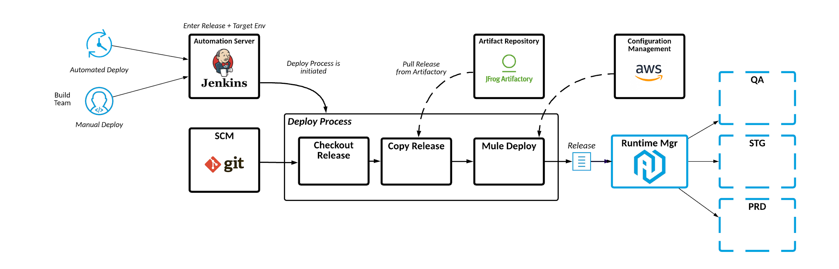
Continuous Delivery

Slide 16
Thank you

